Slide 1

INTERNSHIP STUDIO INTERNSHIP FOR ETHICAL HACKING TASK-3
2024

Slide 2
Insecure Transmission Vulnerability Found
Site Name: Acunetix
URL : http://testasp.vulnweb.com/
Details : In the above mentioned site transfer of Data is found to be done using HTTP instead of HTTPS which very insecure, the passwords while registering for new account or while logging in are transferred using HTTP which can easily be intercepted and exploited.
Impact: An attacker may:
Steal sensitive information like password by intercepting.

Slide 3
STEPS INVOLVED:
Open the link http://testasp.vulnweb.com
On top of website we find search option.
Click on search option we prompted with search box.
Try the XSS script <ifarme src=javascript:alert(1)> in search box.
Here <ifarme src=javascript:alert(1)> works and gives out an response of script injection alert (1).

Slide 4
Solution:
Transfer the working of all the forms on this site which carry sensitive information like passwords from HTTP to HTTPS, So even if an attacker intercepts the connection he still won’t be able to get important information like passwords easily.

Slide 5
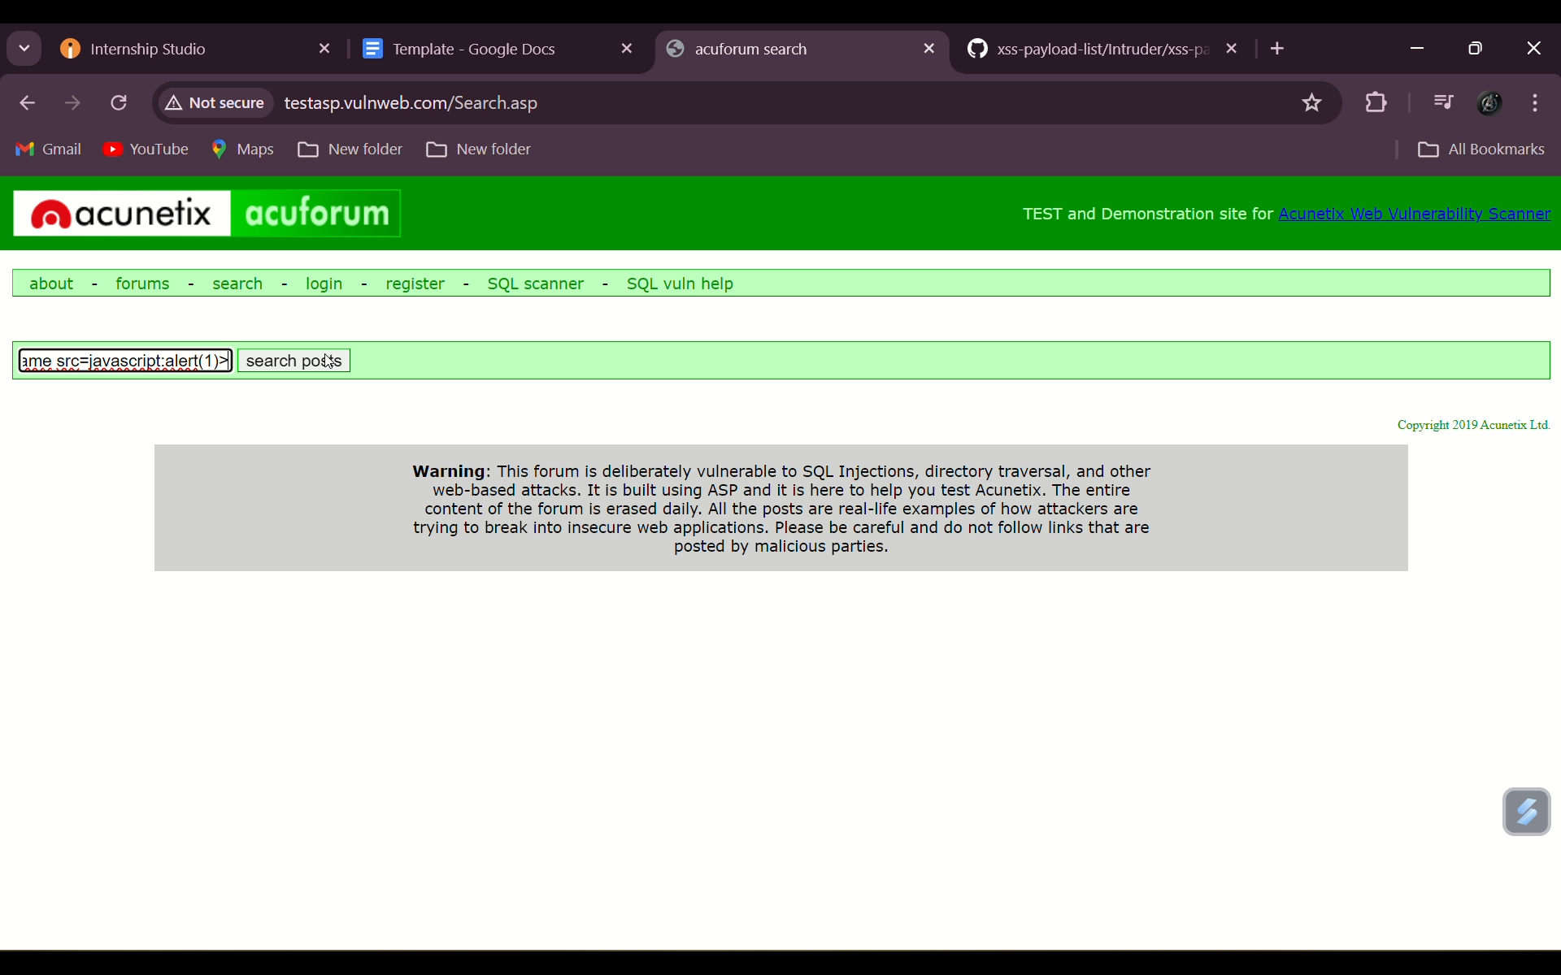

Slide 6
